Slide 1

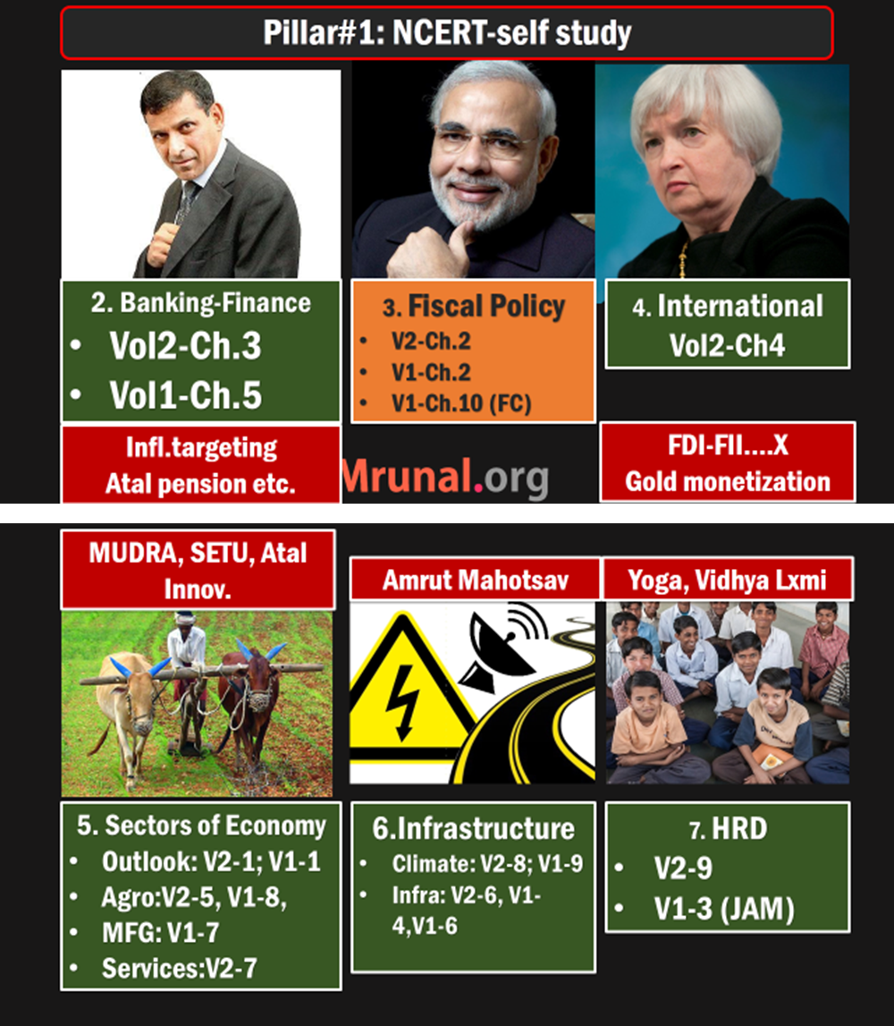
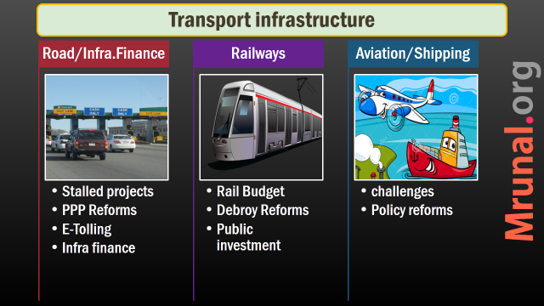
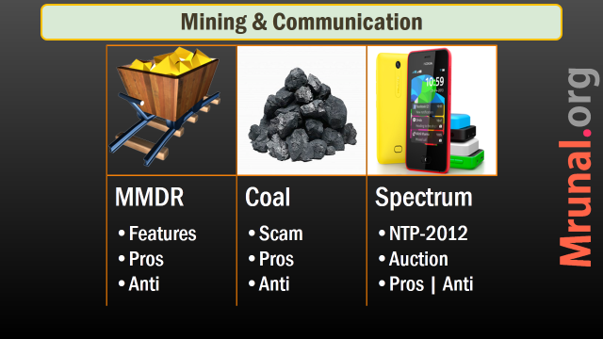

Slide 2
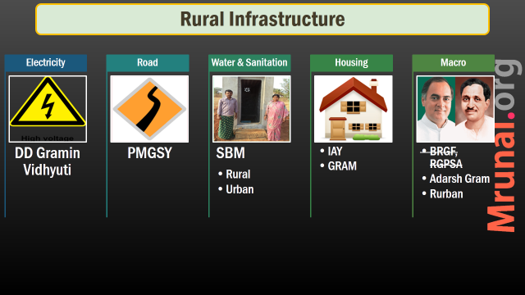
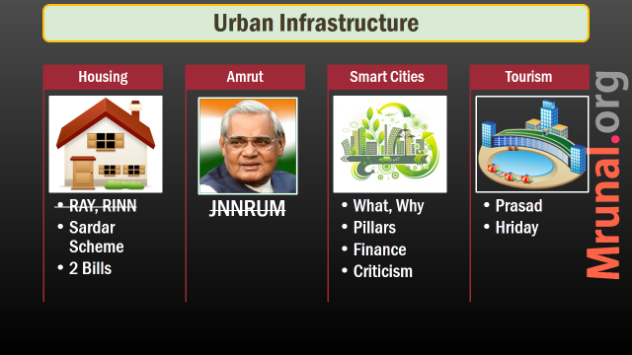
Next time Spectrum, Climate Change

Slide 3

India Yearbook 2015
Ch.24 Urban & Rural Development
Pg.719-MNREGA, NRLM (HRD lecture) IAY, BRGF
723 onwards: Land reforms – mains lectures
737: E-Panchayat
734-740: PRI, Gram Sabha, Shashktikaran, 13th FC. 14th FC (L4/P3.pptx)
Notes:
0 funds for Panchayat shasakti karan

Slide 4
Find Correct statement
Rural drinking water supply is a state subject.
As per 11th Schedule, States must entrust this function to PRI bodies.
Both A and B
Neither A nor B

Slide 5
Find Correct statement: Ans.A
Rural drinking water supply is a state subject. Right
As per 11th Schedule, States must entrust this function to PRI bodies. Wrong. “state may”. (IYB- Pg732, Laxmi 34.9)
Both A and B
Neither A nor B

Slide 6
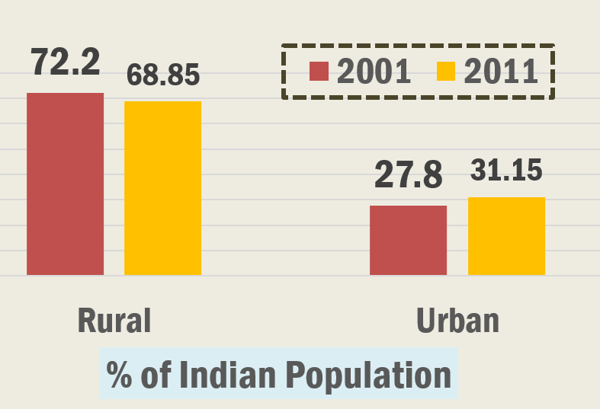
Pop: abs. term both ▲ but % wise Rural ▼

Slide 7
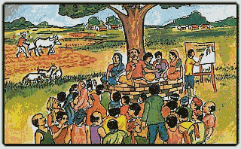
Rural statistics for MCQ
Census 2011
Tier6: <5k pop.
Tier5: 5k to 9999 pop.
Max. villages: UP > MP > Odisha
Lowest Villages: Chandigarh << Laskhdweep << Diu-Daman
Total Villages:5,97,485 = ~6 Lakh
Total Villagers: 80 crore+
Pak., China occupied villages not counted in Census 2011.
Notes:
Afterwards, semi-urban (tier4)

Slide 8
Amrut Mahotsav 2022: 6 pillars (1-3)
Housing
2 cr. urban
4 crore rural
24/7
Water, toilet, road,
electricity
Medcare
Jobs
1 member in each house
Skill India + make in India
housing for all

Slide 9
Rural Infrastructure
Electricity
DD Gramin Vidhyuti
Road
PMGSY
Water & Sanitation
SBM
Housing
Macro
IAY
GRAM
BRGF, RGPSA
Adarsh Gram
Rurban
Urban
Rural

Slide 10
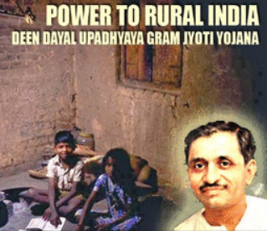
Din Dayal Gram Jyoti
Rural elect.
12th FYP: Rajiv Gandhi gramin vidhyutikaran yojana
Budget 2014: DD Gram Jyoti subsumed RGGVY
Power ministry => Rural electrification corporation (REC) ltd. To get 0.5% commission.
States/Cos-Not eligible: vehicles, tools, salaries, IT application, office equipment etc.

Slide 11
DD Gram Jyoti
Rural Elec.
New substations and high voltage distribution networks.
Feeder line = connects substation to consumers/smaller substations.
Separate feeder lines for agro and non-agro = better load Management.
24/7 electricity to all households by 2019 using 'metered' connections.
Notes:
Focus: households,not agriculture!

Slide 12
DD Gram Jyoti
Rural Elec.
Coordination with Bharat broadband network ltd. (BBNL) to implement NOFN
Private companies eligible for $$
Notes:
Focus: households,not agriculture!

Slide 13
Special cat= J&K, NE, Hill states (HP, UttKH)
Component
Union
State | Co.
Loan
Sp.Cat. States
85
5
10

Slide 14
Fund released depending on completion stage
Component
Union
Normal states
60
State | Co.
Loan
Sp.Cat. States
10
30
85
5
10

Slide 15
Rural Infrastructure
Electricity
DD Gramin Vidhyuti
Road
PMGSY
Water & Sanitation
SBM
Housing
Macro
IAY
GRAM
BRGF, RGPSA
Adarsh Gram
Rurban
Urban
Rural

Slide 16

PMGSY
Rural Infra
State list: roads other than national highways.
2000: Vajpayee Govt. launched
All weather roads, Upgrade existing roads
Unconnected habitats (Census-2001)
500 person (plains)
250 (tribal sch.V, desert, special cat.)
Special cat =J&K, NE, HP, UtKH.
Budget 2015: >14k crore

Slide 17
Rural Infrastructure
Electricity
DD Gramin Vidhyuti
Road
PMGSY
Water & Sanitation
SBM
Housing
Macro
IAY
GRAM
BRGF, RGPSA
Adarsh Gram
Rurban
Urban
Rural

Slide 18
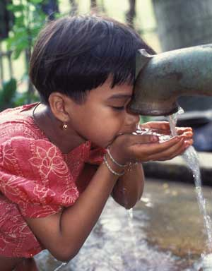
Drinking WATER
Rural Infra
2022: 70 lt. water/capita/day
Within household OR
50m distance
~70% population coverage done
Slippage: groundwater depleted, population rise, passive gram sabha

Slide 19
Rural WATER
Budget-2015
Irrigation
Pradhan Mantri Krishi Sinchai Yojana >5k
Drinking
Swatch Bharat Sanitation 3500 Cr.
National Rural drinking water program (for States) 2500 cr.
Neeranchal Watershed
Micro irrigation
Gram Sinchai

Slide 20
Swatch Bharat
Rural | Urban both

Slide 21
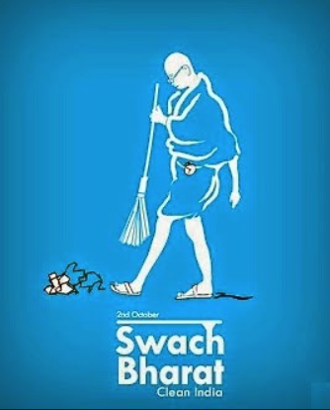
Evolution
Sanitation
1980s: Central rural sanitation program
1999: total sanitation campaign
2012: Nirmal bharat abhiyan
2nd October 2014-2019: Swatch Bharat mission (Rural + Urban). Gandhi 150th anniversary
Open defecation…0%
Manual scavenging….0%

Slide 22
Swatch Bharat: which ministry?
Urban areas
Urban development
Rural areas
Drinking water and sanitation

Slide 23
Din Dayal Antyodaya Yojana: Detailed Article Link
Greemin Kaushalya
Urban
Train 10 lakh in 3 years, PH attention, Intl.Syllabus
Train 5 lakh each year, setup SHG, Cheap Loans, Vendor Training
Ministry of Rural Development
Min. Housing & Urban Poverty Alleviation
Not urban Development ministry

Slide 24
Tourism: Prasad & Hriday (L7/P4.pptx)
Prasad
Tourism Min.
Pilgrimage Rejuvenation and Spirituality Augmentation Drive
Heritage City Development and Augmentation Yojana
Urban Development Min.
Hriday

Slide 25
Swatch Bharat Mission
Organization
Funding
Toilet Types

Slide 26
SBM: organization
@Union
National advisory and review Committee (NARC) under Secretary
Mission directorate under jt. Secretary
@States
high powered Committee under Chief Secretary

Slide 27

Rural Areas Personnel
SBM
District SBM Committee with collector, MP, MLA, NGOs
Gram Panchayat - utilization of funds, including CSR.
Swtachhta Doot

Slide 28

Rural Areas Swatchhta Doot
SBM
foot soldiers- ASHA, Anganwadi workers, PRI, water linemen, SHG, NGO etc.
IEC: information, education, communication.
Triggering-nudging to behavior change.
Rs.150/ per family stopped from open defecation.

Slide 29

Rural Areas accountability
SBM
Vigilance Committees
MIS: Management information system - for physical and financial progress.

Slide 30
Urban Areas Personnel
SBM
District level monitoring Committee, area sabha, ward Committee
training and funding
Awareness generation, behavioral changes.

Slide 31
Swatch Bharat Mission: 0% open defecation 2/10/2019
Organization
Funding
Toilet Types
Union-State
PRI, ULB
S.Doot
IEC

Slide 32
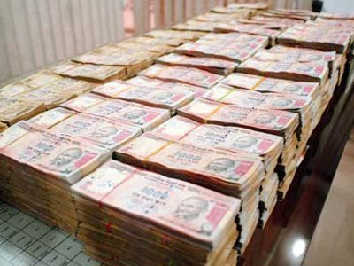
Public Funding
SBM
Funding- 75:25 | 90:10*
*Special category states: J&K, NE, Uttarakhand, Himachal.
15% of fund for awareness only
3% for national media
12% to state Government for plays, workshops etc.

Slide 33
Private Funding
SBM
Capex: capital expenditure
Opex: operation and maintenance
CSR: 2% profit -Companies Act
Railways: Green Curtain around station

Slide 34
Swatch Bharat Mission: 0% open defecation 2/10/2019
Organization
Funding
Toilet Types
Union-State
PRI, ULB
S.Doot
IEC
100% CSS
15% awareness
OPEX, CAPEX, CSR
Rural
urban

Slide 35
SBM: Toilet Types
Rural
@School
Community
Urban
Individual (12k)
Individual
Community toilets
Temporary

Slide 36
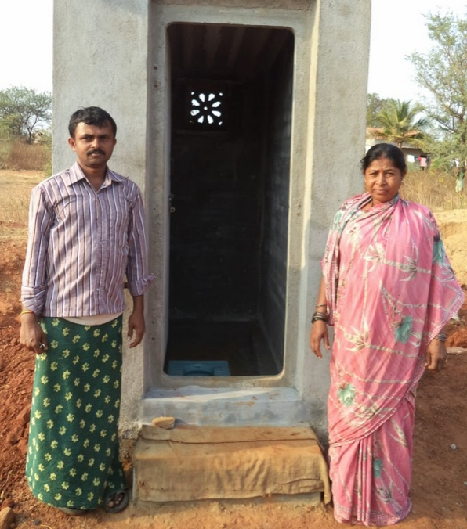
Rural Areas toilets
SBM
Bio toilets, Separate toilets @school.
BPL/APL: Individual household toilet upto Rs.12k.
First priority to pensioners, preg. women, families with girl child.

Slide 37
Rural Areas toilets
SBM
Community sanitary complex: toilet, bathing, washing cloths.
2 Lakh rupees.
Union-state-PRI: 60:30:10.(PRIs given grant from 14th FC).
Other funds
Solid waste Management: 7 to 20 lakh depending on # of households.
National rural drinking water program (NRDWP)
Notes:
PRI got 2 lakh crores under 14th FC grant in aid

Slide 38
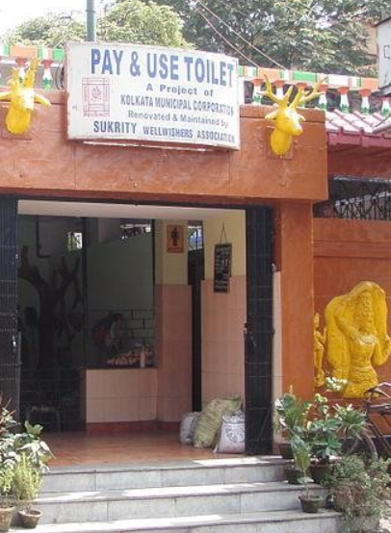
SBM: Toilet Types
Rural
@School
Community (2L)
Urban
Individual (12k)
Individual (4k)
Community toilets
Temporary
Public Toilets (5y)

Slide 39
Urban Areas Toilets
SBM
Individual toilets: @Rs.4000/- per household.
Community toilets: where space constraints @ slums.
Public toilets: at market, office complexes, public transport stations. With five years maintenance contract.
Temporary toilets for construction workers (else smart city =dirty city!)

Slide 40
Urban Areas
SBM
Municipal waste management…100%
Municipal waste Management: Segregate, transport, storage, recycling, treatment.
Notes:
Sanitation plans for city and state

Slide 41
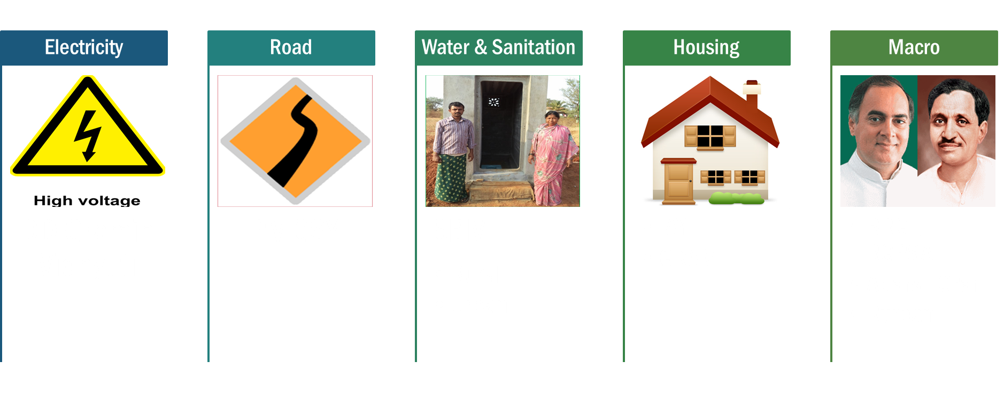

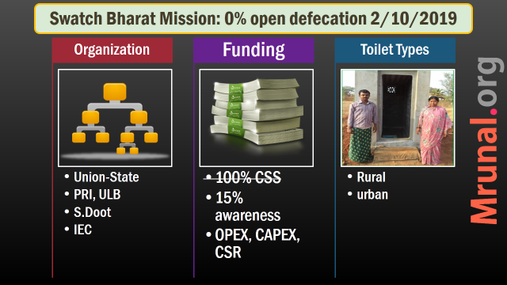
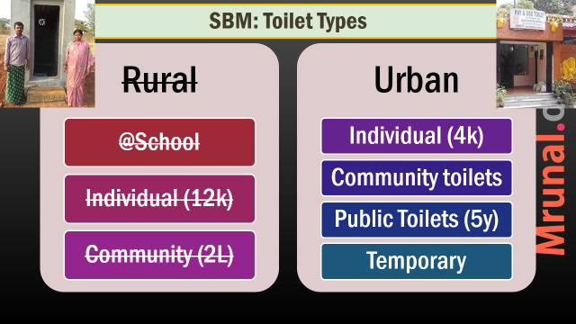

Slide 42
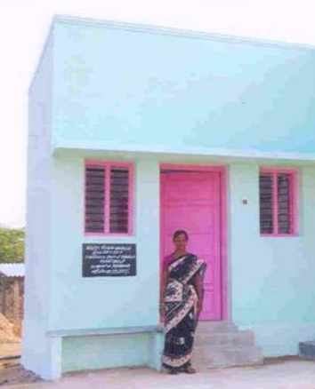
IAY
RURAL INFRA
Under Rural Dvlp. ministry ’85
Gram sabha => Homeless BPL
Budget 2015: 10000+ crores, 60% meant for BPL among SC/ST

Slide 43
GRAM
RURAL
Modi Government proposed
National Gramin Awas Mission
To subsume IAY
Build 60 lakh houses p.a x 7 years
Pucca Housing for all by 2022

Slide 44

Rural housing
GRAM
IAY
Only BPL
Non BPL too, via SECC

Slide 45

Rural housing
GRAM
IAY
70k (plains) 75k (Hills)
30 sq. mt
1.1 lakh
20 sq.mt
Upgradation: 15k, Land buy: 20k

Slide 46
Rural housing: electricity and sanitation
GRAM
IAY
“Dovetailed” with Nirmal Bharat, Rajiv Gramin Vidhutikaran
Toilet: Swatch Bharat Mission (upto 12k)
Electricity: DD Gram Jyoti
But as such ‘optional’

Slide 47
Rural Infrastructure
Electricity
DD Gramin Vidhyuti
Road
PMGSY
Water & Sanitation
SBM
Housing
Macro
IAY
GRAM
BRGF, RGPSA
Adarsh Gram
Rurban
Urban
Rural

Slide 48
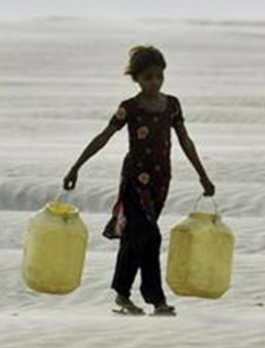
BRGF
Rural Infra
2007: Backward Region Grant Fund (BRGF)
Who? Ministry of Panchayati Raj.
Bottomline: additional money to backward regions within states
for improving infrastructure: water, sanitation, schools, street lights
via PRI, Bottom up

Slide 49
BRGF
Rural Infra
Two components:
District: 272 district (min.1 cr)
State: Bihar, Odisha, W.Bengal, UP (Bundelkhand)
Budget 2014: promised restructure
Budget 2015: Rs.0 allotted, reason: 14th FC 42% tax devolution + 2 lakh crore for PRI grant-in-aid (L4/P3.pptx)

Slide 50
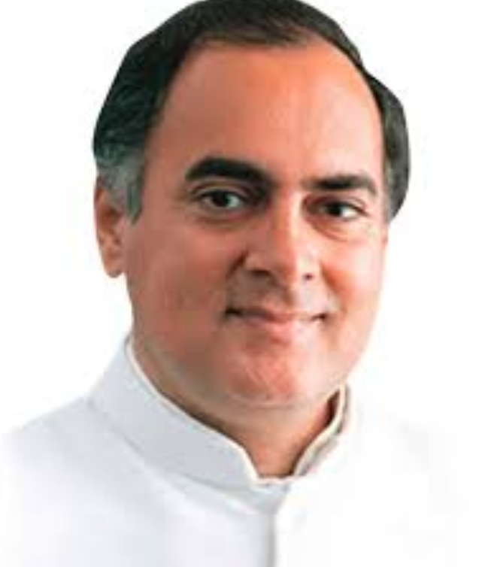
Panchayat Shasaktikaran
Rural Infra
2013: Rajiv Gandhi Panchayat Shasaktikaran Abhiyan (RGPSA)
Ministry of Panchayati Raj
Funding: 75:25 | 90:10*
Panchayat building / renovation, training of official etc.
Budget 2015: Rs.0/- allotted. Reason: reason: 14th FC 42% tax devolution + 2 lakh crore for PRI grant-in-aid (L4/P3.pptx)

Slide 51
BRGF & RGPSA: find wrong statement
Both were implemented through Min. Panchayati Raj
Both received no funding in Budget 2015
Both were 100% Centrally sponsored schemes
None of above.

Slide 52
BRGF & RGPSA: find correct statement
Both were implemented through Min. Panchayati Raj
Both received no funding in Budget 2015
Both were 100% CSS
Answer Choices
Only 1 and 2
Only 2 and 3
Only 1 and 3
All of them

Slide 53
Rural Infrastructure
Electricity
DD Gramin Vidhyuti-
karan
Road
PMGSY
Water & Sanitation
SBM
Housing
Macro
IAY
GRAM
BRGF, RGPSA
Adarsh Gram
Rurban
Urban
Rural

Slide 54
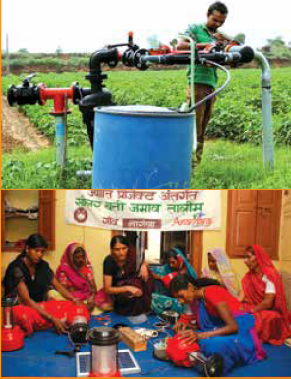
Sansad Adarsh Gram 2014
Rural infra.
Rural Development ministry.
MP adopts & develops one model village in their constituency
Nominated member: any village in India
Rajya Sabha MP: state where he was elected

Slide 55
Sansad Adarsh Gram 2014
Rural infra.
Plains: 3k-5k population
Hill: 1k-3k population
should not be his / spouse' village
Adopt 1 by 2016
Adopt 2 by 2019
Till 2024: 1 each year= 5
By 2024: 6433/2.65 lakh GP

Slide 56
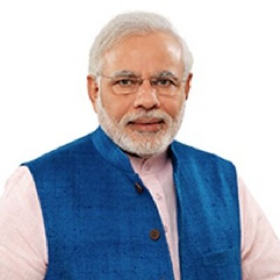
Sansad Adarsh Gram
Rural infra.
PM adopted Jayapur, Varanasi.
Rajnath: Benti / Lucknow
(RS) Smriti Irani: Manghrol, Anand Dist / Guj.
(RS) Jaitley: 4 villages in Dabhoi Taluka, Vadodara district Gujarat viz. Karnali, Pipaliya, Valida, Baglipura
Rahul Gandhi: Deeh / Amethi
Sonia: Udwa / Rae Bareli
(Nom.) Sachin: Puttamraju Kandriga (AP)
Notes:
Success depends on enthusiasm of MP, Villagers and district administration.

Slide 57
Sansad Adarsh Gram WHY?
Rural infra.
Unlike MPLADs, No money to be given. Only social mobilization and people’s power.
Money: unfair allocation to beneficiaries. Political partisanship: real and perceived.
Casteism, communalism, liquor abuse, child marriage, dowry can't be fixed through laws & schemes
Model village to influence nearby villages=>overall rural Development.

Slide 58
Sansad Adarsh Gram Value system
Rural infra.
Celebrating girl child, plant tree
Birthday of village, b'day of freedom fighter /martyr from village.
Adarsh gaan (village song)
Cleanliness drive, Wash hands before eating
Run library through donation.
MP Personal attention to various schemes’ implementation
holding public officials accountable
Notes:
Success depends on enthusiasm of MP, Villagers and district administration.

Slide 59
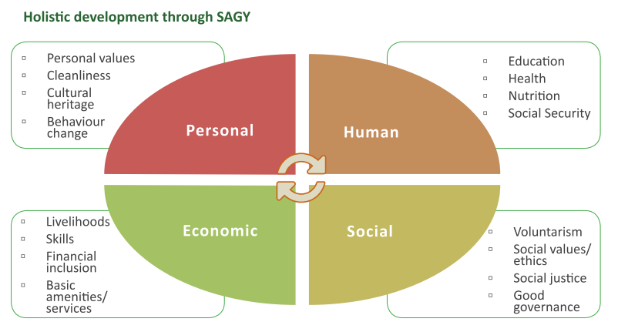
Adarsh gram: holistic Development

Slide 60
Mock Mains/ Interview
Socio-economic transformation of Rural India can’t be achieved without inculcating the sense of pride & volunteerism among its citizens. Discuss the importance of Sansad Adarsh Gram Yojana in this regard.
Celebrate girl child =women discrimination..X
Martyrs, Village song =caste barrier
Library through donation= caste barrier
Tree planting, cleanliness drive

Slide 61
Rural Infrastructure
Electricity
DD Gramin Vidhyuti-
karan
Road
PMGSY
Water & Sanitation
SBM
Housing
Macro
IAY
GRAM
BRGF, RGPSA
Adarsh Gram
Rurban
Urban
Rural

Slide 62
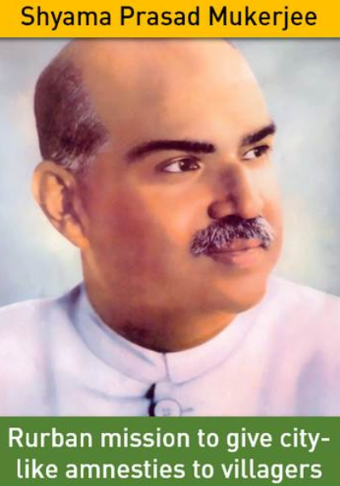
Shyma Prasad Rurban
Rural Infra.
2004: UPA’s PURA (Providing Urban Amenities in Rural Areas)
PURA Kalam’s brainchild.
PURA Model: @Periyar, Chitrakoot, Warana and Loni.
PURA failed due to lack of convergence among ministries

Slide 63
Shyma Prasad Rurban
Rural Infra.
Modi Budget 2014
Rs. 0 Allotted to PURA
Shyama Prasad Mukherji Rurban Mission (SPMRM)
Rural Development ministry
Funding: 60:40 | 80:20, PPP

Slide 64
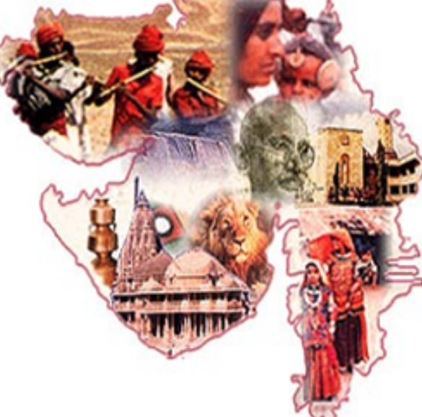
Shyma Prasad Rurban
Rural Infra.
11 Member Committee under Rural Development Addl. Secretary
Studying Gujarat Rurban Development model

Slide 65
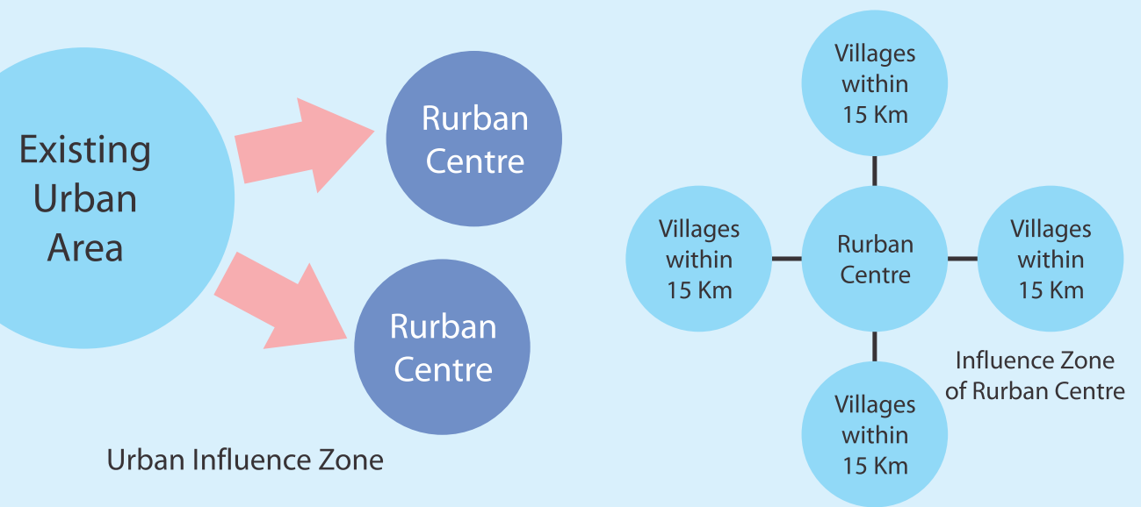
Guj: Rurban center & Rurban cluster
Taluka HQ
OR Village ~10k pop.
50k public covered

Slide 66
Gujarat* / PURA / RURBAN: connectivity ▲
End result? Rurbanization: creating big villages with urban feel
Physical
Communication
Knowledge
Road
Electricity (Jyotigram*)
Telecom
Internet (NOFN)
Polytechniques
Vocational training
Civic infra.
PHC, Schools
E-gram Panchayat
Mass transport
Finance
Kiosk Banking
Tax incentives
Culture-Sport infra (Panchvati*)
Cheap loans
Notes:
Important for Perishable-milk

Slide 67
Mock question for Mains/Interview
Discuss in brief, the importance of Rurbanization /Rurban mission for bringing down the divide between India vs Bharat | Rural vs Urban / promoting reverse migration
Meaning: big village with urban feel.
Connectivity- physical, communication, knowledge
Public investment=> private industry will come automatically
▲ Jobs, civic amnesties = ▼ migration, ▲ per capita income
Notes:
GS1 : urbanization and problems

Slide 68
Rural Infrastructure
Electricity
DD Gramin Vidhyuti-
karan
Road
PMGSY
Water & Sanitation
SBM
Housing
Macro
IAY
GRAM
BRGF, RGPSA
Adarsh Gram
Rurban
Urban
Rural

Slide 69
Historical figures
Pt. Madan Mohan Malviya
Dr. Shyama Prasad Mukhrjee
Pt. Din Dayal Upadhyaya

Slide 70
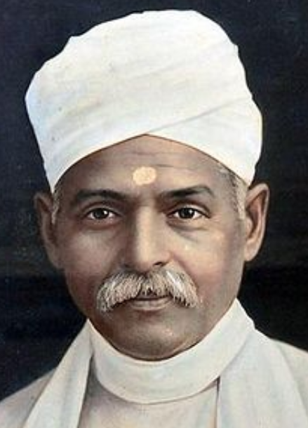
Pt.Madan Mohan Malviya
1861-1946
Lawyer from Allahabad,
Member of provincial & central legislature.
Founder: Banaras Hindu University (BHU), Hindu Mahasabha, “The Leader” newspaper.
Editor of The Hindustan, Indian Union and Abyudaya.
Moderate INC leader, 4x President
Gandhiji gave title “Mahamana”
Popularized slogan “Satyamev Jayate”

Slide 71
Pt.Madan Mohan Malviya
1861-1946
Opposed separate electorate for Muslims under Lucknow pact of 1916
Was in 1st RTC 1930
Setup Congress Nationalist Party to oppose communal award
Budget 2014: Teachers training program
Malviya’s Birthday 25th December (same as Vajpayee).
44th Bharat Ratna, 2014. (Vajpayee -45th)

Slide 72
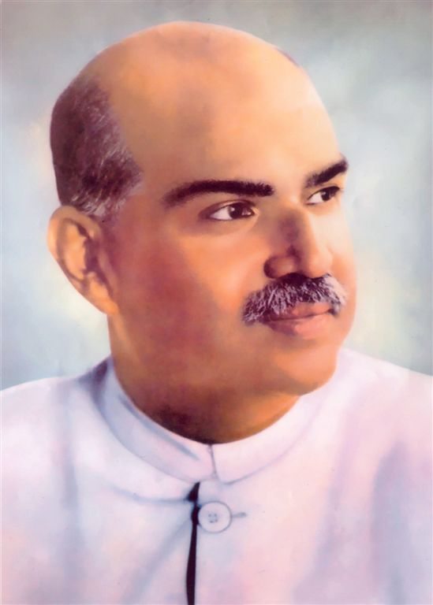
Dr. Shyama Prasad Mukharjee
1901-1953
UK Barrister, Youngest VC of Calcutta Univ.
Active in Asiatic Society
President Hindu Mahasabha
Bharatiya Jansangh founder
Opposed Sarat Suharawady pact (to create “Bengal country)
Free India: Industry minister
Pro-Uniform civil code, Anti-370, No to Delhi pact
Scheme: Rurban mission

Slide 73
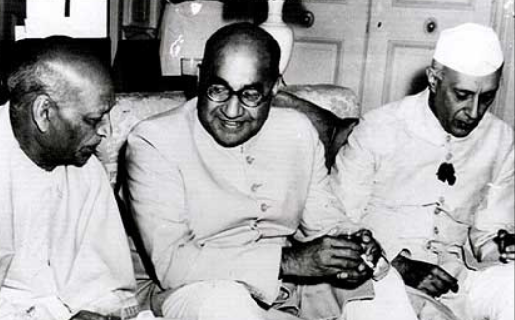
Delhi Pact?
History
PM Nehru vs PM Liaqat Ali Khan 1950
Post-partition Refugee rehab.
Return women, Property, “Ghar wapsi” (forced conversions unrecognized)
Equality citizenship to minorities
Appoint minority commission to implement above things.
Dr.Mukhrjee resigned because 2 past pact fail, Pak won’t enforce this.

Slide 74
Historical figures
Pt. Madan Mohan Malviya
Dr. Shyama Prasad Mukhrjee
Pt. Din Dayal Upadhyaya

Slide 75
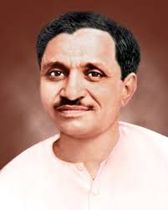
Pt. Deendayal Upadhyaya
1916-1968
Born Mathura dist. UP. (Modi 1 year completion speech)
Bharatiya Jan Sangh (BJS): General Secretary for 15 years
Political philosophy “Integral Humainism” (BJP)
Editor of Panchjanya and Swadesh
Scheme: Gram Jyoti, Antyodaya Yojana

Slide 76
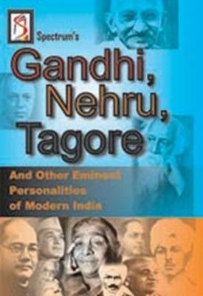
Freedom fighters
Spectrum Publication:Gandhi, Nehru Tagore & other eminent Personalities of Modern India
Freedom fighter: chronology, area of operation, newspapers periodicals
Moderate, extremist, leftist, revolutionary, women, Anglo-Indian, Non-Indian, NE, South

